Slide 1

QUAD COP
Members:
Adarsh Jagan S
Prakash Baskaran
Sabhari Natarajan

Slide 2
The Problem
Large crowds gathering in small area during festivals/political meetings etc.
These areas are prone to thefts, stampedes, terrorist activities.

Slide 3
Our Proposal
Use quad copters with two cameras(front and back) mounted on them.
Process live feed from cams for face detection and then recognition.
On a suspect match the operator at base station is requested for confirmation to follow him until police force reaches the spot/ operator aborts.

Slide 4
If no match found
Quad cop flying around the crowded place
Camera sends live stream of video to the base station
Facial recognition is done and each face is compared with the people in wanted list
Continue search
If match found
Follows the criminal and updates its position to the base station
Checks if it can track the criminal under the given conditions
Quad cop is instructed to follow the criminal and police forces are alerted
YES
Track
NO
Command from base station
Alerts base station to take manual control to follow the criminal using the live feed
Return and search for new criminals
Don’t Track

Slide 5
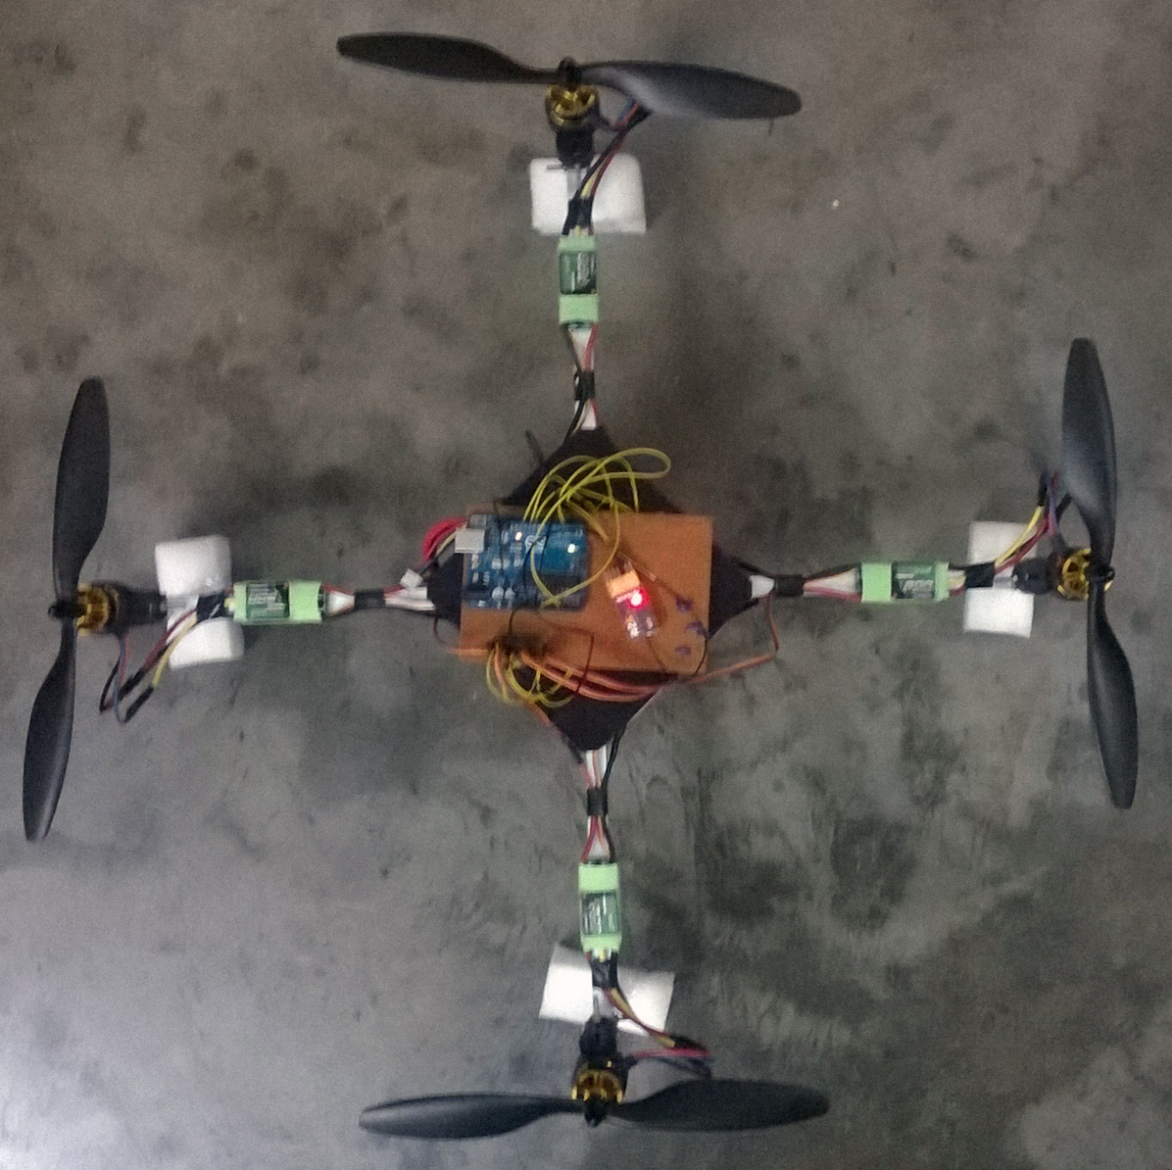
Gallery

Slide 6
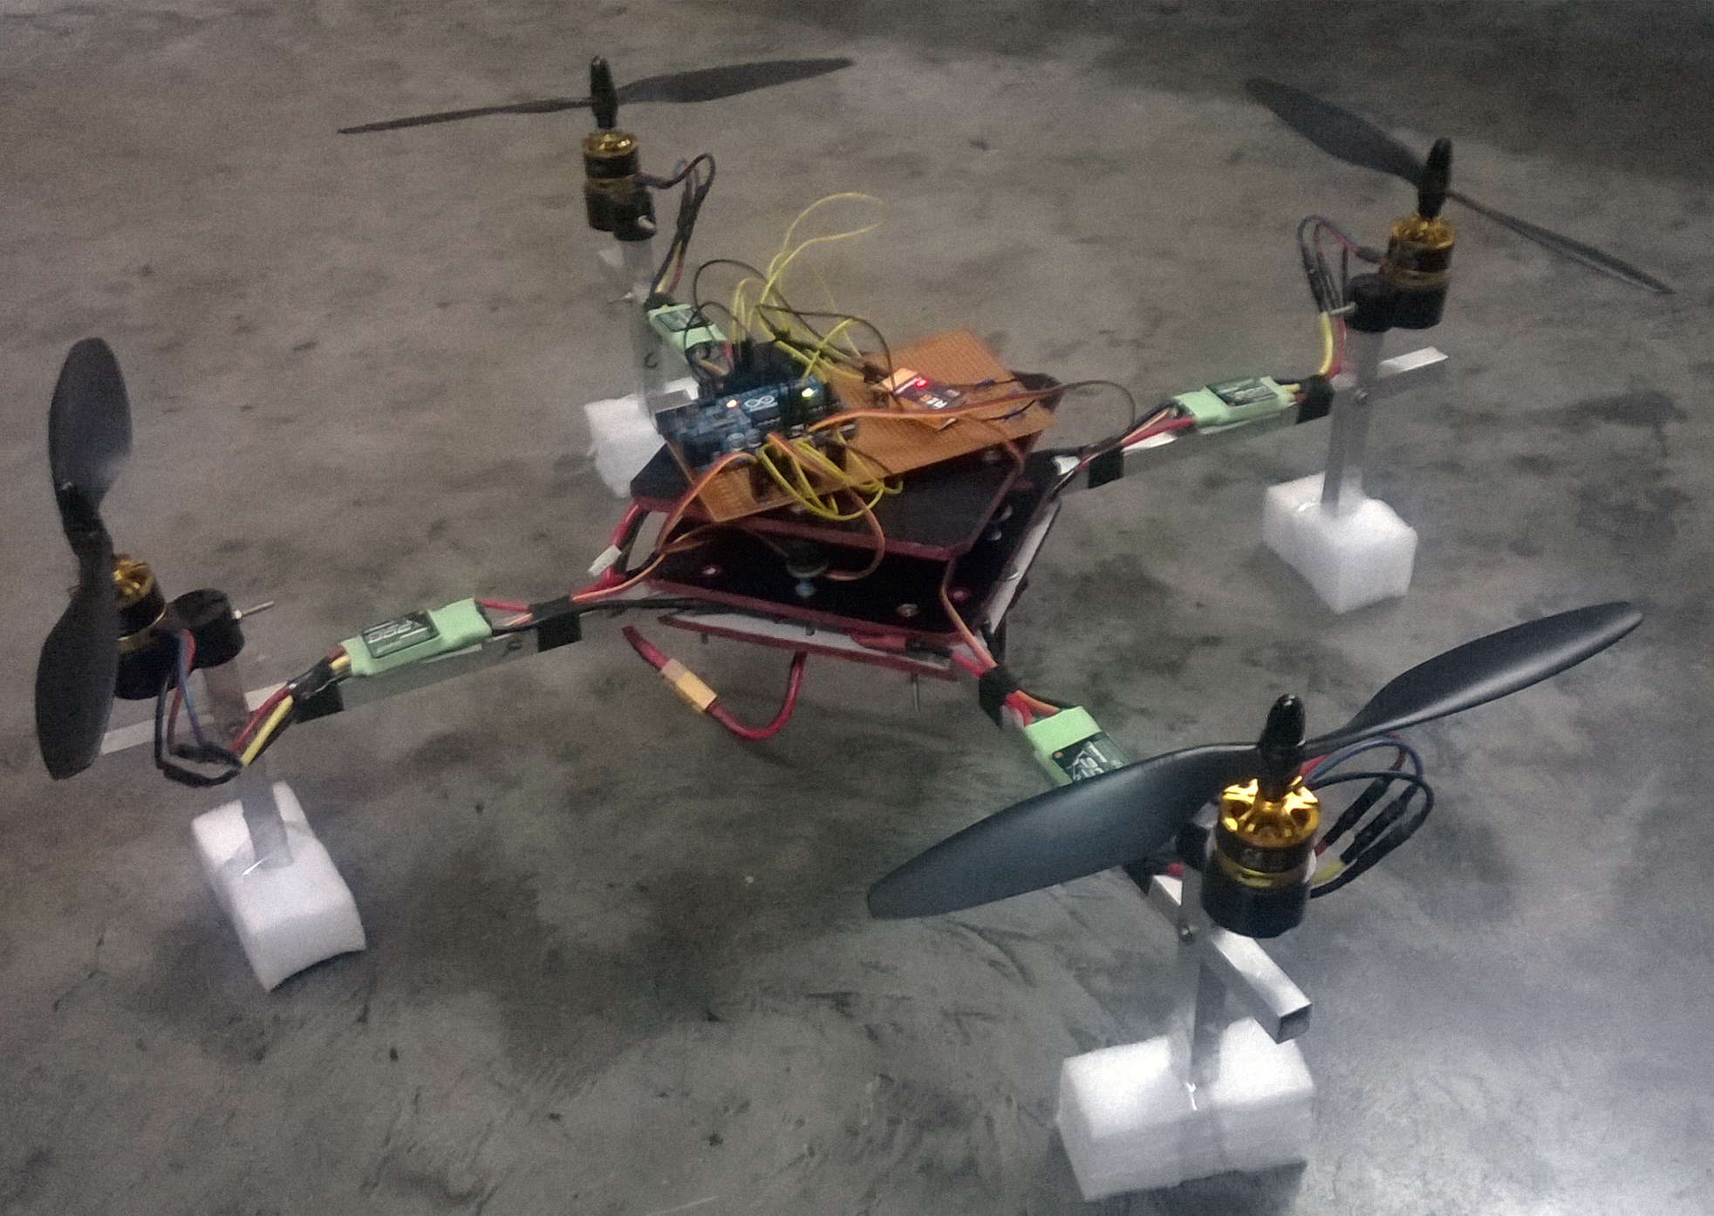

Slide 7
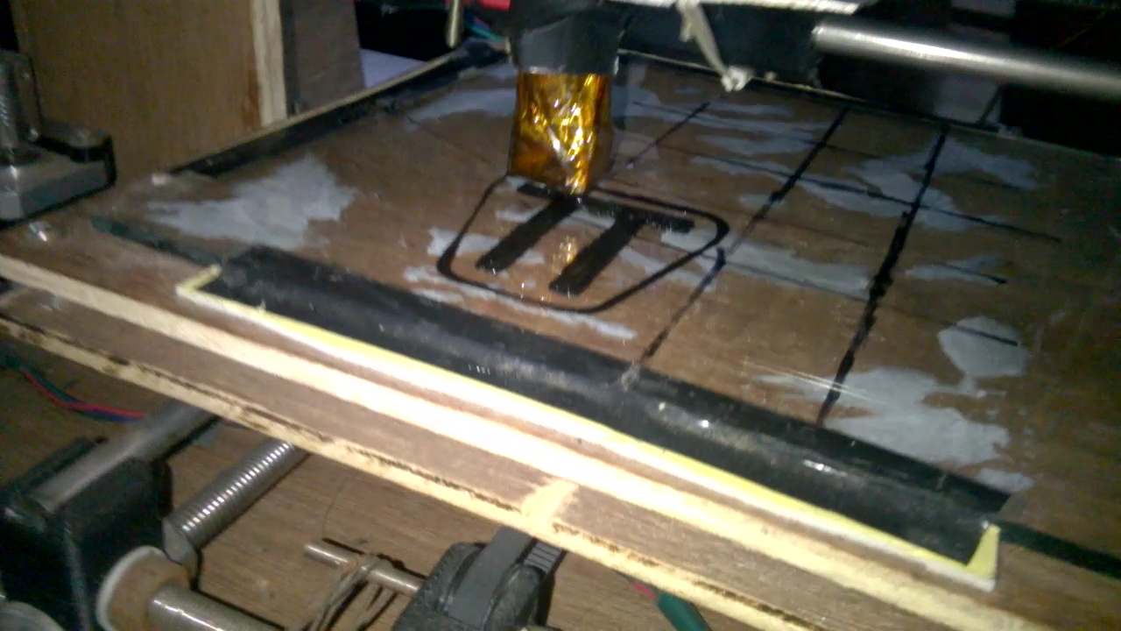
3D printed L clamp for gimbal mounting

Slide 8


Slide 9
Overview on how HAAR and other object detection cascades work

Slide 10
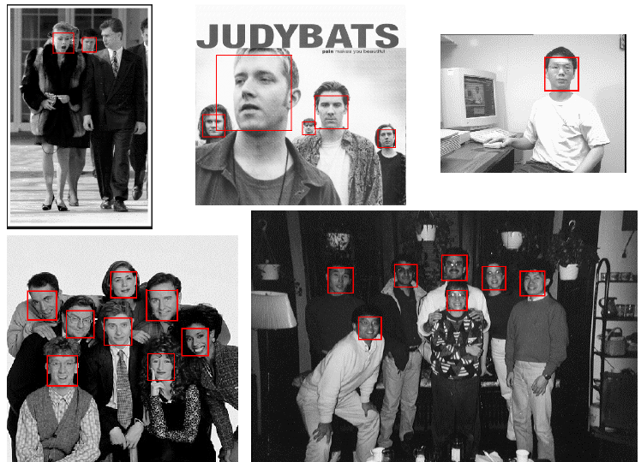
Face Detector: Results
Notes:
10

Slide 11
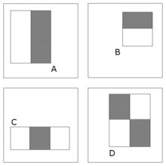
Haar-features (1)
The difference between pixels’ sum of the white and black areas
Notes:
Four types, put on different locations with different scales

Slide 12
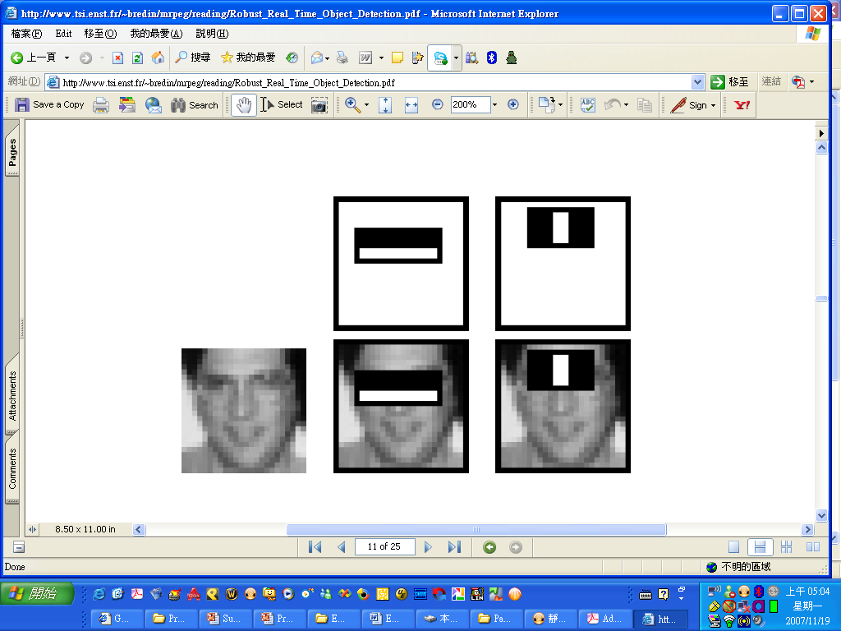
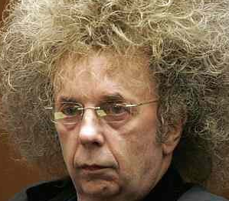
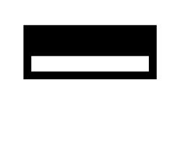
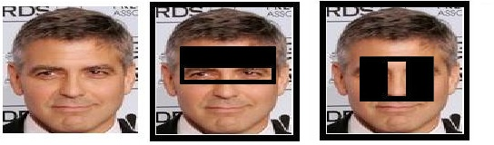
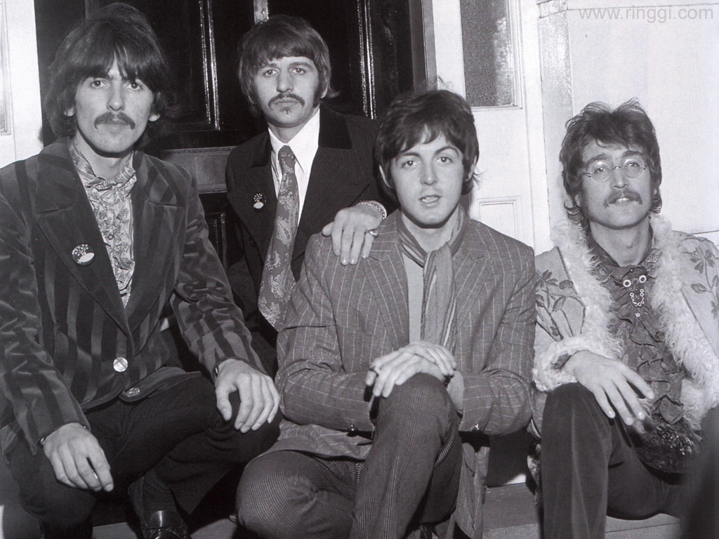
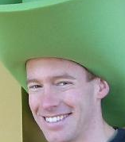
Haar-features (2)
Capture the face symmetry

Slide 13
Haar-features (3)
Type A
Four types of haar features
A 24x24 detection window
Can be extracted at any location with any scale!

Slide 14

Haar-features (4)
24
24
Too many features!
location, scale, type
180,000+ possible features associated with each 24 x 24 window
Not all of them are useful!

Slide 15


Feature selection
A weak classifier h
f₁
f₂
f₁ > θ (a threshold) => Face!
f₂ ≤ θ (a threshold) => Not a Face!
1 if f_{i} > θ
h =
0 otherwise

Slide 16
Feature selection
Idea: Combining several weak classifiers to generate a strong classifier
……
α₁
α₃
α₂
α_{T}
α₁h₁+ α₂h₂ + α₃h₃ + … + α_{T}h_{T}
><
T_{thresold}
~performance of the weak classifier on the training set
weak classifier (feature, threshold)
h₁ = 1 or 0
Notes:
feature: type, location, scale

Slide 17
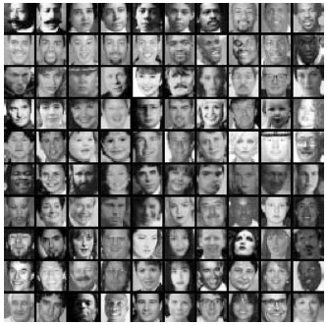
Feature selection
Training Dataset
4916 face images
non-face images cropped from 9500 images
non-face images
positive samples
negative samples

Slide 18
Basic framework
Build/train object model
Choose a representation
Learn or fit parameters of model / classifier
Generate candidates in new image
Score the candidates

Slide 19

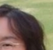
Window-based models Generate and score candidates
Scans the detector at multiple locations and scales
face/non-face Classifier

Slide 20


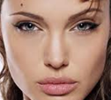
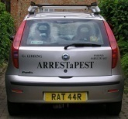
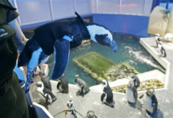
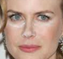
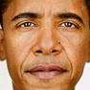

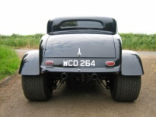
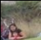
Window-based object detection
Training:
Obtain training data
Define features
Define classifier
Given new image:
Slide window
Score by classifier
Training examples
Face/non-face Classifier
Feature extraction

Slide 21
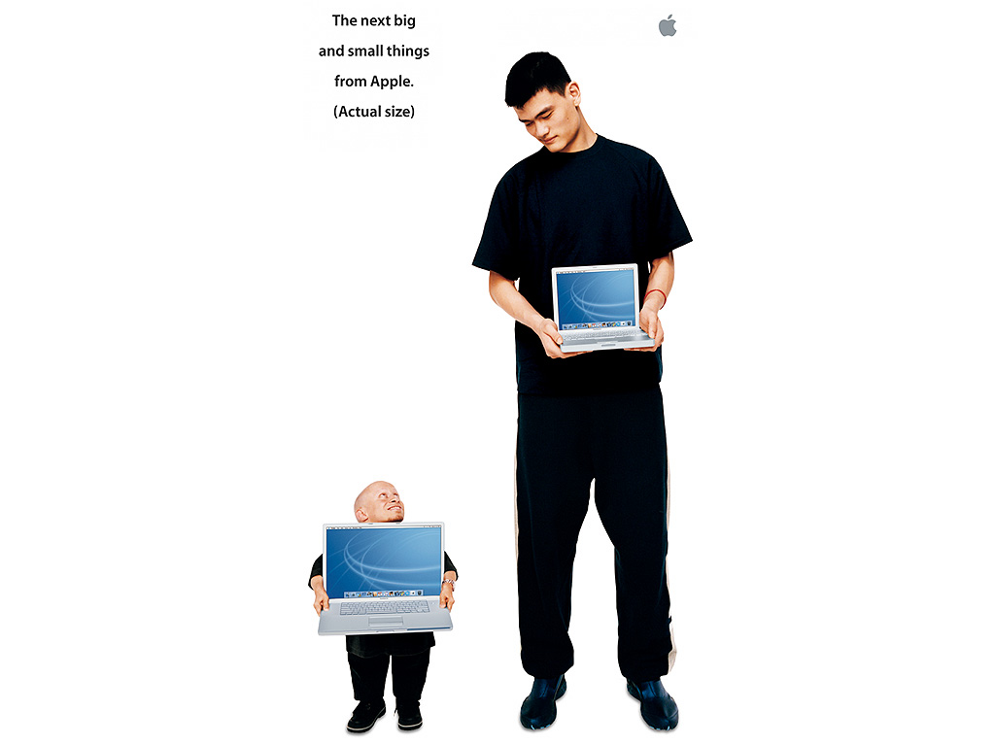
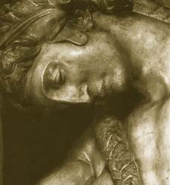
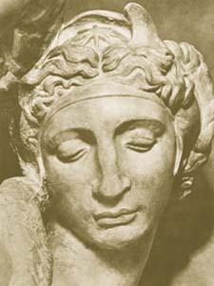
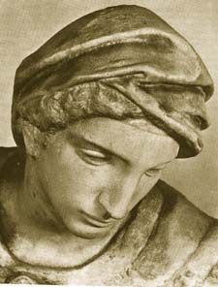
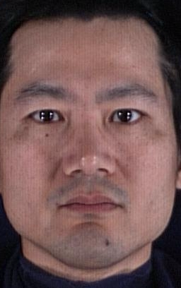
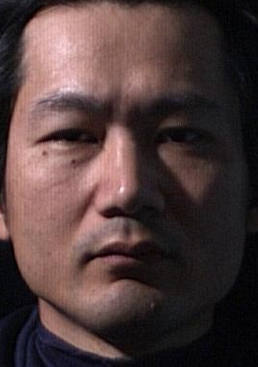
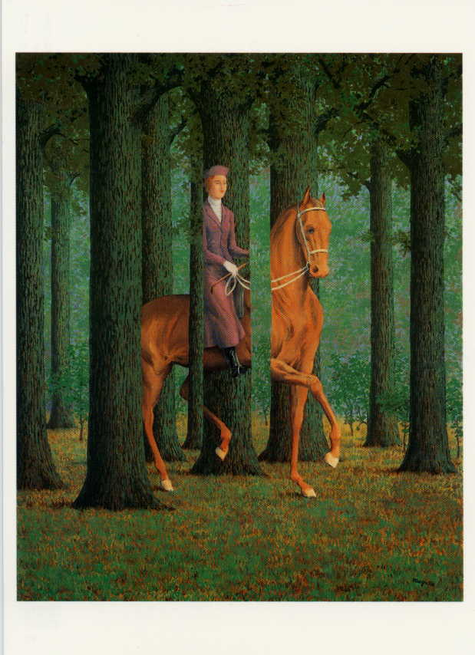
Challenges
scale
view point variation
illumination
occlusion
Magritte, 1957

Slide 22
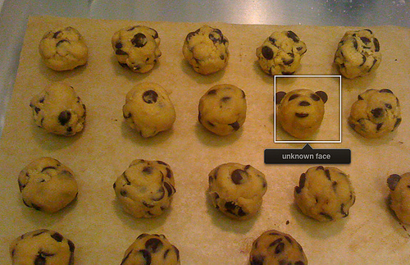
Wrong Detection
Things iPhoto thinks are faces

Slide 23
